Slide 1
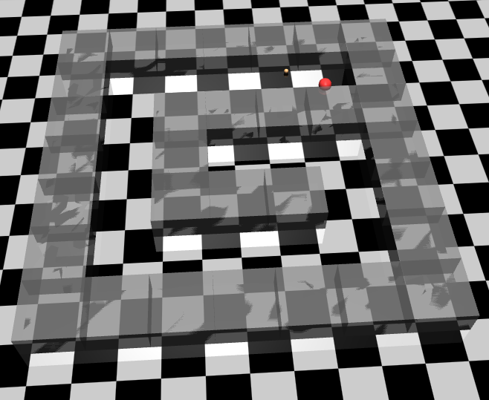
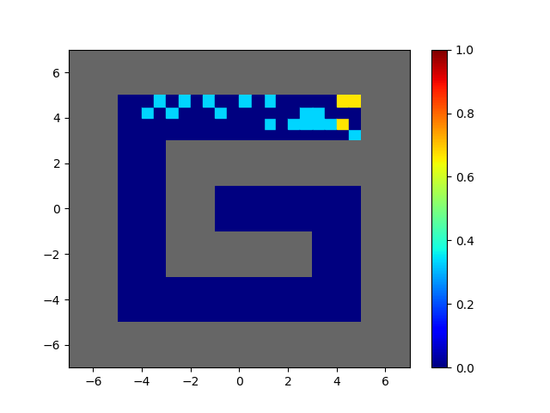
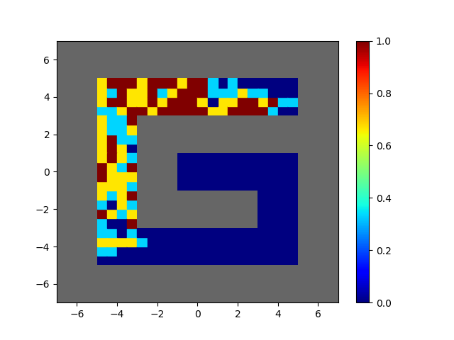
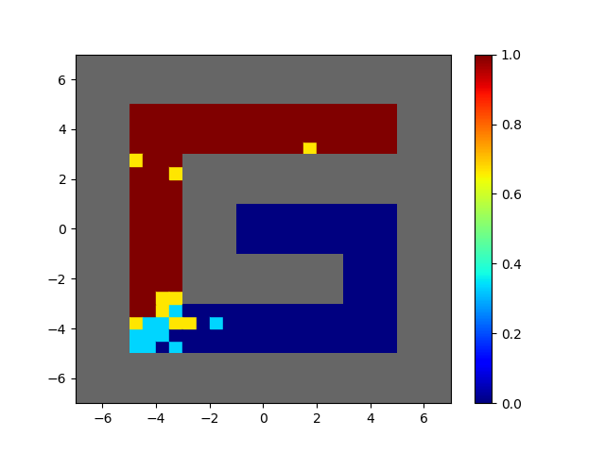
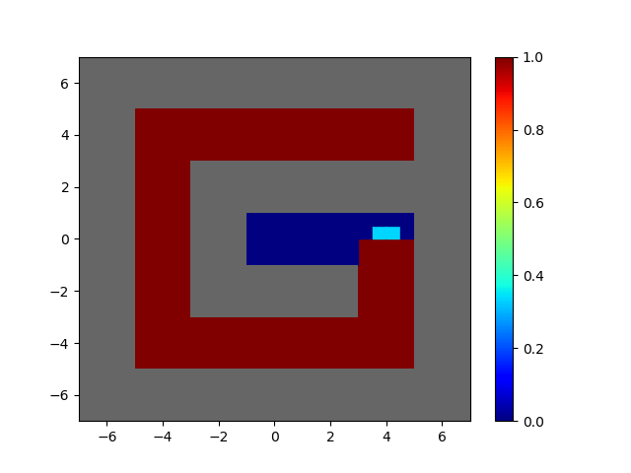
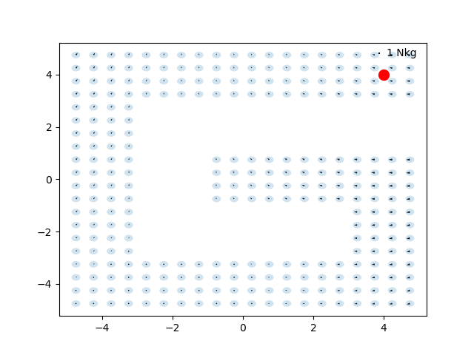
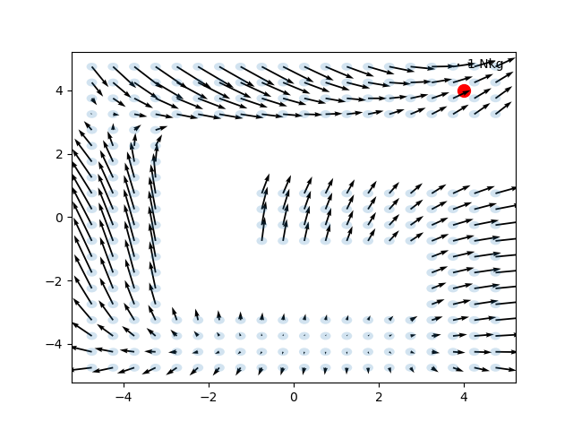
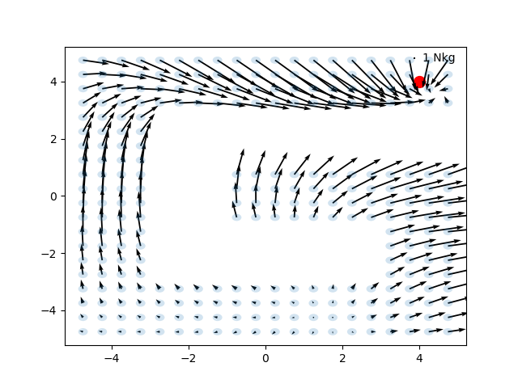
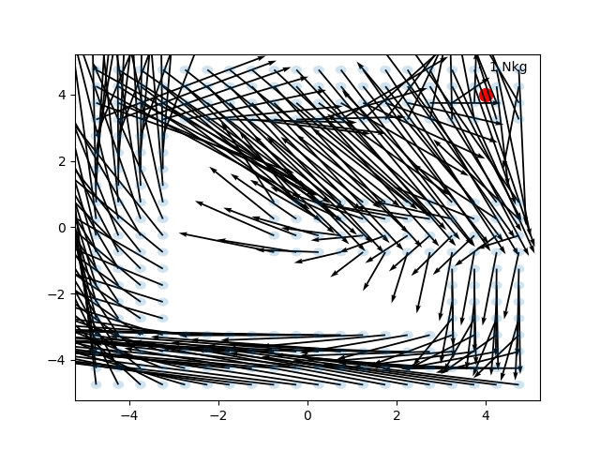
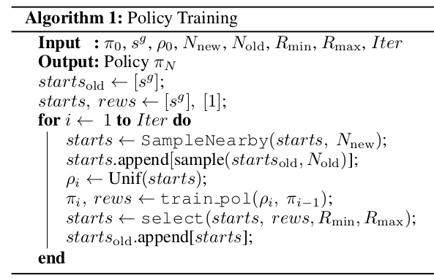
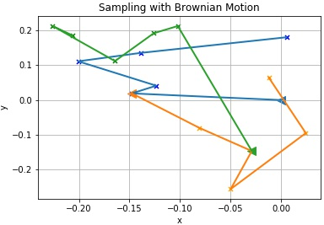
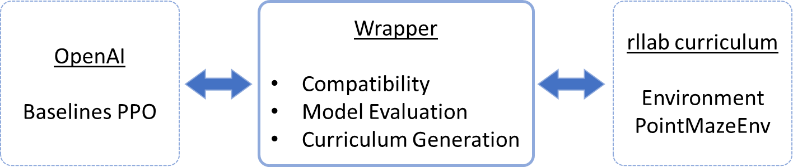
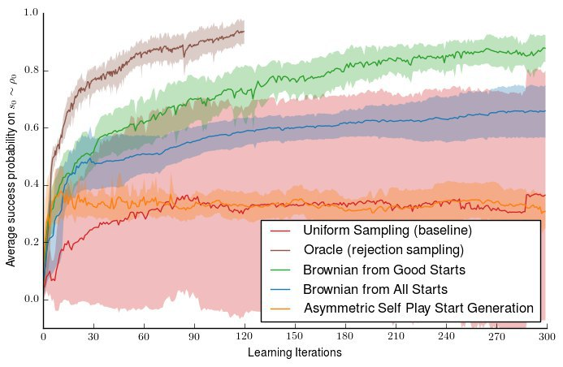
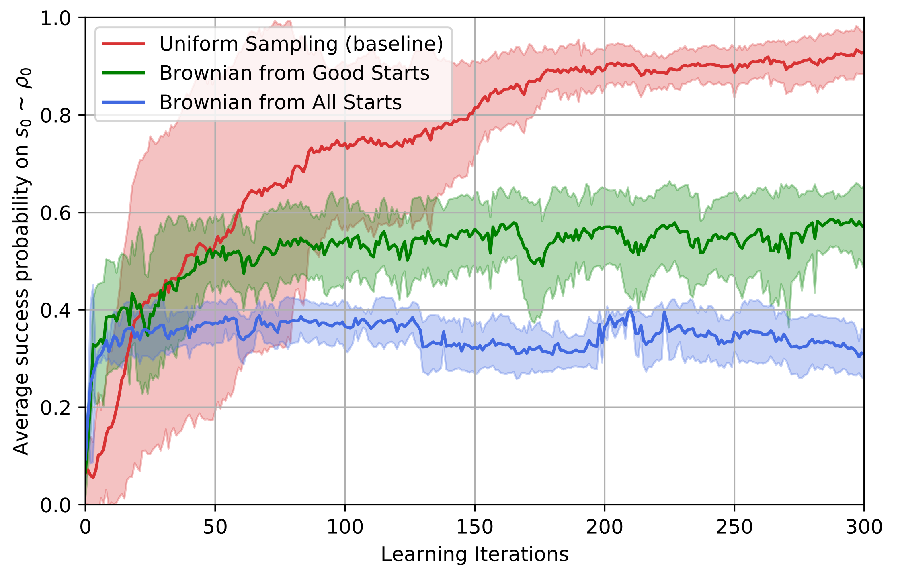
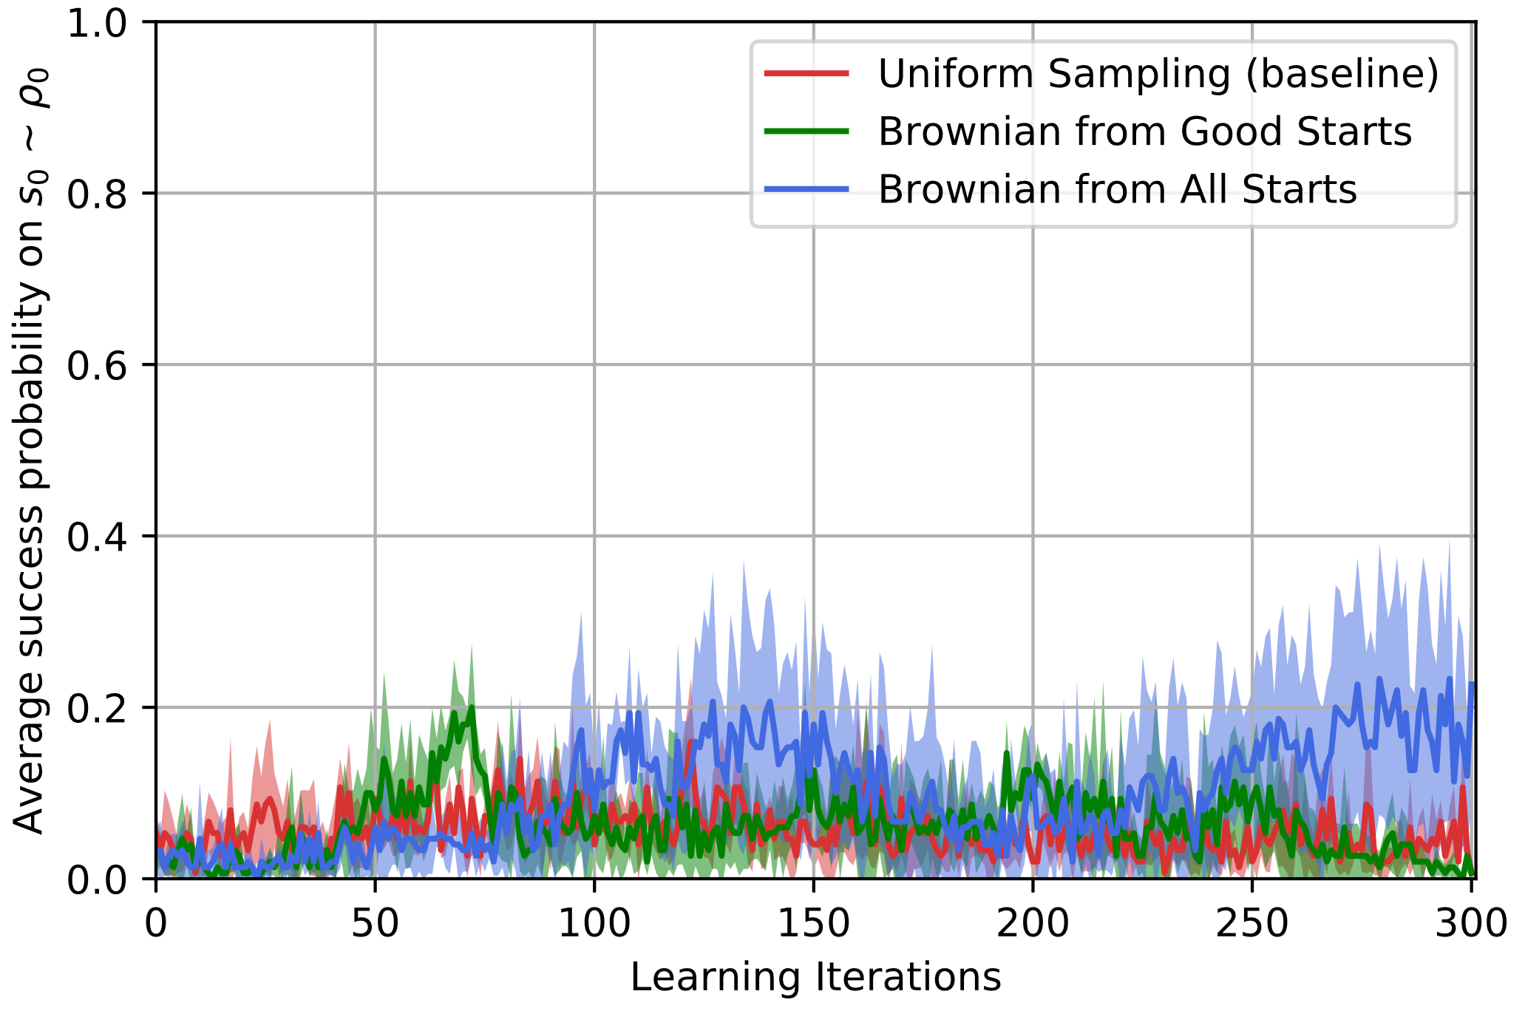
Reverse Curriculum Amadeus Hovekamp, Megan Klaiber, Hans Nübel, Rabea Turon
Project Idea
Reproduce the results of „Reverse Curriculum Generation for Reinforcement Learning“ [1]
Using Code provided by the authors of the paper
Using a RL environment from the paper and OpenAI baselines RL algorithm
Reverse Curriculum idea: Start training from states close to the goal and gradually move further away
Adaptive Curriculum Generation
Alternative to uniform sampling over all states
Sample from Start States of current iteration
Generate new Start States with Brownian Motion
Select starts according to sampling method
From all Previous
Good Starts only
Algorithm 1 from [1]
Wrapper
Contains our implementation
Connects OpenAI to rllab curriculum environment
Results
(a) Original results from [1]
(b) Reproduced results with rllab curriculum code
(c) OpenAI Baselines PPO
We were not able to reproduce the results: substantial differences between their results in (a) and the results rerunning their code (b)
Surprisingly, uniform sampling outperformed the more sophisticated methods
Reimplementation of Algorithm 1 and using Proximal Policy Optimization as training method shows bad results, see (c)
Brownian Motion from both Good and All Starts performed better than Uniform Sampling in our implementation
Issues
Problems in original code (rllab curriculum)
Incompatibility of OpenAI algorithms and rllab curriculum environments
Differences between code and paper
References
[1] Florensa, C., Held, D., Wulfmeier, M., Zhang, M. & Abbeel, P.. (2017). Reverse Curriculum Generation for Reinforcement Learning. Proceedings of the 1st Annual Conference on Robot Learning, in PMLR 78:482-495

